Slide 1
Voice based email system for blinds
AVIRAL & Divanshu
Mentor - DR.Vipin kumar

Slide 2

AGENDA
INTRODUCTION
PRIMARY GOALS
Technologies
Launch plan
TIMELINE
Issues while coding pics

Slide 3

INTRO
The application is a web-based system designed for visually impaired individuals. It utilizes Interactive T2S technology allowing users to control their email accounts entirely through voice commands. Users can perform actions like reading, sending emails, and other tasks using their voice. The system guides users with voice prompts to execute specific actions, and users respond through voice commands and mouse clicks. Notably, this system eliminates the need for a keyboard, making it more accessible for visually impaired users.

Slide 4
PRIMARY GOAL
for the betterment of society and giving an equal status to such specially abled people we have come up with this project idea which provides the user with ability to send mails using voice commands without the need of keyboard or any other visual things.

Slide 5
What tech we using
REACT JS
NODE JS
EXPRESS JS
CSS3
BOOTSTRAP
v5.0

Slide 6

tech OPPORTUNITIES ARE LIKE BUSES. THERE'S ALWAYS ANOTHER ONE COMING.
“
”

Slide 7
PLAN FOR PRODUCT LAUNCH
Mid November
Assigned date
12/09/2023
PLANNING
planned this project in the month on September.
DESIGN
Currently we are designing our system.
Using waterfall model
LAUNCH
STRATEGY

Slide 8
TIMELINE
SEP(MID) 2023 | Assigned
SEP 25/09/2023 | Create SRS and Synopsis
SEP-OCT 2023 | Designing and Coding
OCT (Last) 2023 | Testing
NOV (MID) 2023 | Launching

Slide 9

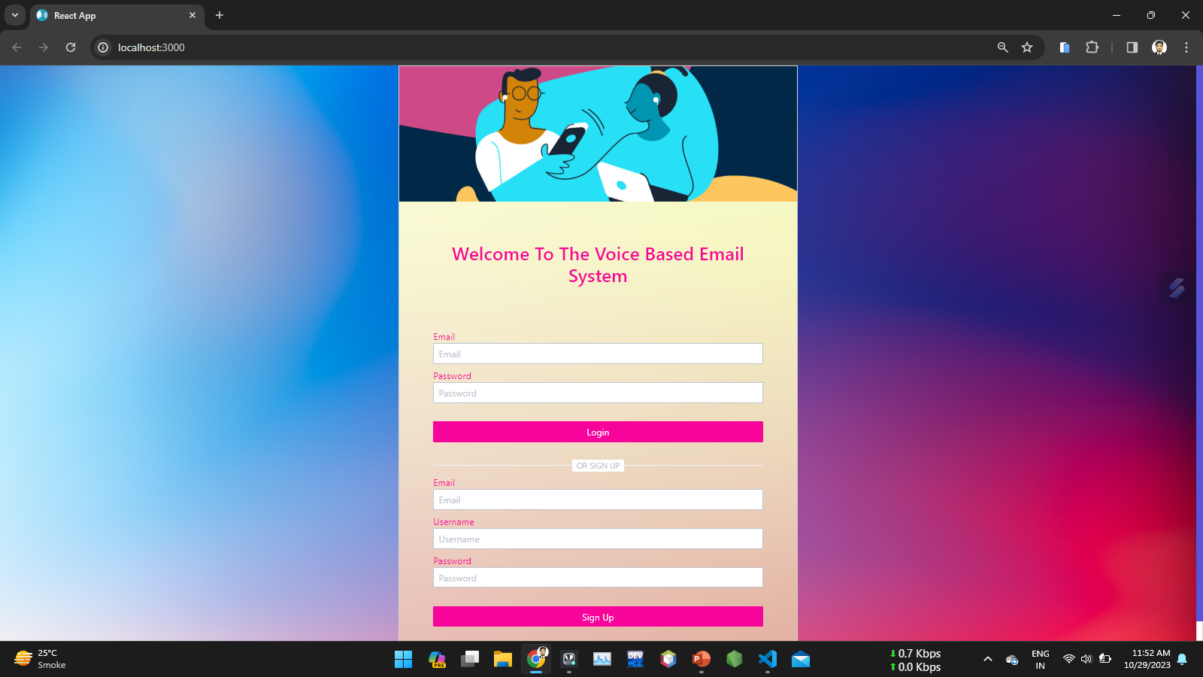
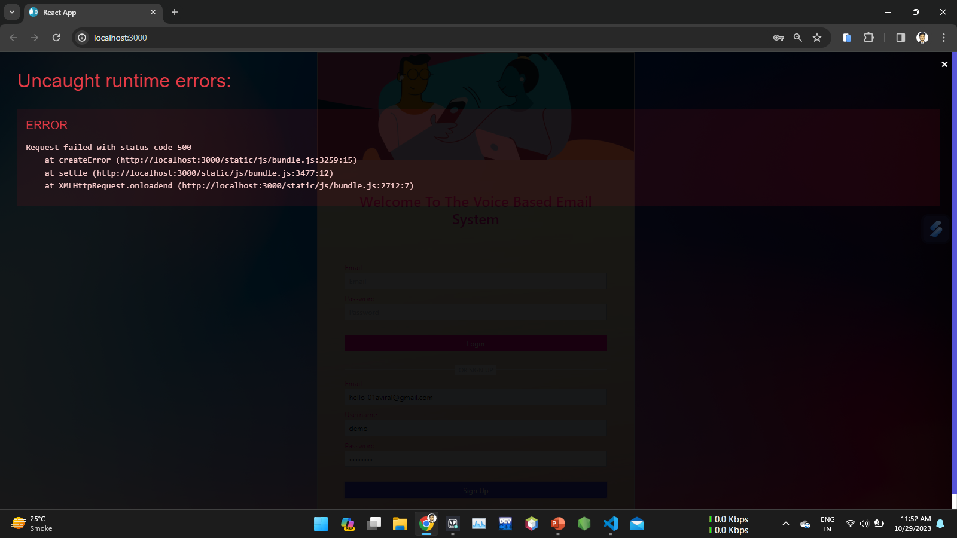
Testing Pics

Slide 10
THANK YOU
Aviral Divanshu Aggrawal
aviral.2224mca1119@kiet.edu

